Slide 1
Module 3
Cascading style sheets(CSS)

Slide 2
The Cascading Style Sheets are used to bring different styles to a document.
Cascading Style Sheets is a style sheet language used for describing the presentation semantics of a document written in a markup language
CSS was formed from an idea of keeping the structure separate from the presentation
most important benefit of style sheets is their capability of imposing consistency on the style of Web documents.

Slide 3
Cascading Style Sheets (CSS1) was developed in 1996 by the W3C .
Second standard CSS2 was developed in mid-1998.
CSS2.1 was developed in 2004 –fully supported by browsers such as IE8+, C5+ and FX3+
CSS3 development was started in 1999 and finished in 2014- majority of web browsers today implement CSS3
Latest version is CSS4 was released March 24. 2017.

Slide 4
Levels of Style Sheets
CSS is called Cascading style sheets because they can be defined at three different levels .
Lower-level style sheets can override higher-level style sheets
The three levels of style sheet are
inline
document level
external

Slide 5
Inline style sheet apply to the content of a single element.
Document level style sheet apply to the whole body of a document
External style sheets can apply to the bodies of any number of documents
Inline style sheets have precedence over document style sheets which have precedence over external style sheets
If no style sheet information is specified then the browser default property values are used

Slide 6
Inline style specifications
appear within the opening tag and apply only to the content of that tag.
Disadvantage
Does not impose a uniform style on the tags of at least one whole document
style information, which is expressed in a language distinct from XHTML markup, being embedded in various places in documents.

Slide 7
Document-level style specifications
Appear in the document head section and apply to the entire body of the document.
an effective way to impose a uniform style on the presentation of all of the content of a document.

Slide 8
External style specification
are not part of any of the documents to which they apply.
stored separately and are referenced in all documents that use them
Clear separation of CSS and HTML.
External style sheets are written as text files with the MIME type text/css.

Slide 9

The <link> tag is used to specify external style sheets.
the rel attribute is used to specify the relationship
href attribute of <link> is used to specify the URL of the style sheet document
The link to an external style sheet must appear in the head of the document.
Eg:

Slide 10

Style Specification Formats
The format of a style specification depends on the level of style sheet.
Inline style specifications appear as values of the style attribute of a tag.

Slide 11

Document style specifications appear as the content of a style element within the header of a document.
The type attribute of the <style> tag tells the browser the type of style specification, which is always text/css for CSS.

Slide 12

Each style rule in a rule list has two parts:
a selector, which indicates the tag or tags affected by the rule
a list of property–value pairs.
Eg:
p {font-size: 1.1em; font-style: italic; font-family: ’Times New Roman’; }
CSS comments are introduced with /* and terminated with */
The external file consists of a list of style rules. NO <style> tag.

Slide 13
Selector Forms
A selector specifies the elements to which the following style information applies.
The selector can have a variety of forms
Simple Selector Forms
Class Selectors
Generic Selectors
id Selectors
Contextual Selectors
Universal Selectors
Pseudo Classes

Slide 14
Simple Selector Forms
The simplest selector form is a single element name, such as h1.
the property values in the rule apply to all occurrences of the named element.
h1 {font-size: 24pt}
selector could be a list of element names separated by commas- the property values apply to all occurrences of all of the named elements
h1, h2 {font-size: 24pt}

Slide 15
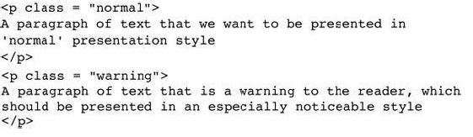

Class Selectors
used to allow different occurrences of the same tag to use different style specifications.
A style class is defined in a style element by giving the style class a name, which is attached to the tag’s name with a period.

Slide 16
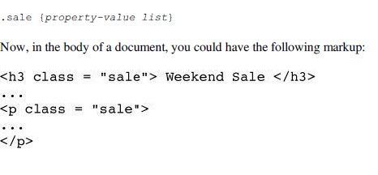
Generic Selectors
A class of style specifications that applies to the content of more than one kind of tag.
defined without a tag name in its name.
use the name of the generic class, which must begin with a period

Slide 17
id Selectors
id selector allows the application of a style to one specific element
#specified-id {property-value list}
Universal Selectors
denoted by an asterisk (*)
applies its style to all elements in a document
* {property-value list}

Slide 18
Contextual selectors
Style should apply only to elements in certain positions in the document.
Simplest form of contextual selector is the descendant selector.
Element B is a descendant of element A if it appears in the content of A.
A particular element can be selected by listing one or more of the ancestors of the element in the selector, with white space separating the element name.
ul ol { property –value list}

Slide 19
Pseudo Classes
Pseudo classes are styles that apply when some action occurs
The pseudo classes hover and focus are supported by new browsers
The names of pseudo classes begin with colons
h2: hover { property-value list}
The style of hover pseudo class applies when the mouse cursor moves over the associated element
The style of the focus pseudo class applies when its associated element has focus

Slide 20
Property Value Forms
CSS includes large number of different properties.
Commonly used categories: fonts, lists, alignment of text, margins, colors, backgrounds, and borders.
Property values can appear in a variety of forms
Keyword property values- only a few possible values and they are predefined
Number values- either an integer or a sequence of digits with a decimal point and can be preceded by a sign (+ or -)
Length values-number values followed immediately by a two-character abbreviation of a unit name

Slide 21
Percentage values-provide a measure that is relative to the previously used measure.
Percentage values can be signed
a plus sign, the percentage is added
if negative, percentage is subtracted.
Color property values-specified as color names, as six-digit hexadecimal numbers, or in RGB form.

Slide 22
Font Properties
the most commonly used of the style-sheet properties
Font Families
used to specify a list of font names.
The browser uses the first font in the list that it supports.
font-family: Arial, Helvetica, Futura;
If a font name has more than one word, the whole name should be delimited by single quotes
font-family: ‘Times New Roman’;

Slide 23
Font Sizes
Specifies the size of the font
font-size: 10pt;
Two categories of font-size values, absolute and relative.
Absolute categories-the size value could be given as length value or as keyword
Keyword- xx-small,x-small, small, medium, large, x-large and xx-large.
Relative size values are smaller and larger.
Percentage values can also be used to adjust the font size relatively.

Slide 24
Font Variants
property can be set to small-caps to specify small capital characters
default value-normal
Font Styles
font-style property is most commonly used to specify italic
font-style: italic;
another possible value is normal -specifies the font to be normal
Font Weights
used to specify the degree of boldness
Possible values- normal, bold, bolder and lighter.

Slide 25
font-weight: bold
The bolder and lighter values are taken as relative to the current level of boldness
Specific numbers also can be given in multiples of 100 from 100 to 900
where 400 is the same as normal and 700 is the same as bold
Font Shorthands
If more than one font property must be specified, the values can be stated in a list as the value of the font property.
font: bold 14pt ‘Times New Roman’ Palatino;

Slide 26
order in which the property values are given in a font value list is important.
font names must be last,
the font size mustbe second to last, and
the font style, font variant, and font weight, when they are included, can be in any order but must precede the font size and font names.
Only the font size and the font family are required in the font value list.
font.html

Slide 27
Text Decoration
used to specify some special features of text.
available values are line-through, overline, underline, and none, which is the default.
text-decoration: line-through;
text decoration.html
Text spacing
letter-spacing property controls the amount of space between the letters in words.
This spacing is called tracking.
Possible values are normal or any length property value.
letter-spacing: 1px;

Slide 28
word-spacing : space between words in text can be controlled.
Line-height : space between lines of text can be controlled. This space is called leading

Slide 29
List Properties
Two presentation details of lists can be specified in HTML documents:
the shape of the bullets that precede the items in an unordered list
the sequencing values that precede the items in an ordered list.
The list-style-type property is used to specify both of these.
list-style-type property of an unordered list can be set
disc - small filled circle,
circle -unfilled circle,
Square- filled square. list prpty ul.html

Slide 30
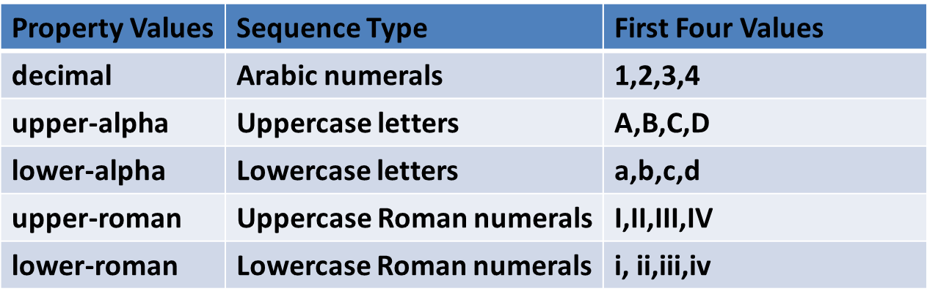
Any image can be used in a list item bullet
Such a bullet is specified with the list style-image property, whose value is specified with the url form.
list-style-image: url( small_airplane.gif);
The list-style-type property can be used to specify the types of sequence values. list prprty ol.html

Slide 31
Alignment of Text
The text-indent property can be used to indent the first line of a paragraph.
This property takes either a length or a percentage value
text-indent: 0.5in; text indent.html
text-align property, for which the possible keyword values are left, center, right, and justify, is used to arrange text horizontally
text align.html

Slide 32
The float property is used to specify that text should flow around some element, often an image or a table.
possible values for float are left, right, and none, which is the default.
text float.html

Slide 33
Color
The color property is used to specify the foreground color of HTML elements.
color: orange;
color-foreground.html
The background-color property is used to set the background color of an element
background-color: red;
color-background.html

Slide 34
The Box Model
The space between the border and an adjacent element is called its margin
The space between the content of an element and its border is known as padding
This model is called box model

Slide 35
Borders
Every element has a property border-style that controls the style of the border
The border style can be dotted, dashed, double or none the default
The styles of four sides of an element can be border-top-style, border-bottom-style, border-left-style and border-right-style
The border-width property is used to specify the thickness of border
The values of border-width can be thin, medium, thick or a length value in pixels
The width of four borders of an element can be different and can be specified by border-top-width, border-bottom-width, border-left-width and border-rigth-width

Slide 36
The color of border is controlled by border-color property
The individual borders of an element can be colored differently using border-top-color, border-bottom-color, border-left-color and border-right-color
Shorthand for setting style properties of all four borders of an element is border property
Can specify style for each individual cell in a table as:
td, th { border: thin solid black;}
table border.html

Slide 37
Margins and Padding
The padding is the space between the content of an element and its border
The padding properties are named padding that applies to four sides of an element the padding-left, padding-right, padding-top and padding-bottom
The margin is the space between the border of an element and the elements neighbors
The margin properties are named margin that applies to four sides of an element the margin-left, margin-right, margin-top and margin-bottom
margin and padding.html

Slide 38
Background Images
The background-image property is used to place an image in the background of an element
The background image is replicated as necessary to fill the area of the element
The replication of the image can be controlled with the background-repeat property
The background-repeat property can take values no-repeat, repeat-x, repeat-y and repeat the default

Slide 39
The no-repeat value specifies that just one copy of the image is to be displayed
The repeat-x value means that the image is to be repeated horizontally and repeat-y means to repeat vertically
The position of a nonrepeated background image can be specified using background-position property
Keyword values are- top, center, bottom, left , right and combination of these.
https://www.w3schools.com/cssref/tryit.asp?filename=trycss3_background_multiple2

Slide 40
Span and Div Tags
In some cases it is necessary to have a word or phrase in a line to appear in a different font size or color and the <span> tag is used for this purpose
The purpose of <span> tag is to change property values of part of a line of content
span.html
In some documents there are sections that consists of a number of paragraphs that have their own presentation styles
The <div> tag can be used to apply a style to a section of a document rather than each paragraph
div.html

Slide 41
THANK YOU

